Slide 1
JAVA MINI PROJECT
BUILDING MANAGEMENT SYSTEM
GUIDE:
PROF. -VIKI PATIL
BY 034 K SURYANARAYAN DORA
025 ARVIND SONKAR
027 SHANI SHARMA
033-RAHUL PADWAL

Slide 2
Content:
Introduction
Existing System
Limitation Of Exisiting System.
Advantages Of Our System.
Design Details.
Flow Chart.
Result
Conclusion
References

Slide 3
INTRODUCTION
Building management system manages the data of the citizens and events of society.
BMS also manages the society fund which will be used in upcoming events.
In BMS a person will be able to create a account if he/she is the society member and it will help to give the information of family members .
It helps to pay maintenance bill if he/she has not paid and if paid it will show “PAID”.
It also shows Water bill and Electricity bill options.
In simple words, with help of BMS society work can done easily and in a systematic way .

Slide 4
EXISTING SYSTEM
MY SCOCIETY CLUB It provides services like instant maintenance bill generation, smart notification through mobile apps, Pay maintenance bills by CC/DC/NB, Alert reminder on outstanding dues, Instant notices and circulars, fully integrated accounting system with automated trial balance.
SOCIETY N MORE It reach out and interact with society members from anywhere in a secured environment. Easy to access member and tenant database from anywhere. 100% automation in billing with autodue reminder and online payment facility. Society document can be stored online for east access.

Slide 5
LIMITATIONS OF
EXISTING SYSTEM
High cost maintenance.
1. For maintenance of existing system more man power is required to the system because of that maintenance of existing system become so costly to maintain.
2. It will burden to average person.
Non-availability of important facilities of average person.
1. For paying bill like electricity bill, water bill etc. It required external sources.
2. There is not a facility for complains & suggestion.
3. For complain of society or building required complicated process.
Complicated system.
1. The system is very complicated to use for each and every person.
2. Due to unwanted and unusual option it becomes more complicated to do frequently required things.
3. And because of that such unwanted things system lags and consume more time.
Paid application Existing system charge extra money for their application for maintaining the app.

Slide 6
ADVANTAGES OF OUR
BUILDING MANAGEMENT SYSTEM
Maintenance Payment Schedule: Using this feature, the management committee members can quickly send a generate payment schedule to collect maintenance dues from all apartment owners.
Maintenance Collection: The transaction of the maintenance bill is one of the most important tasks.
Publish Notice for Your Society: Resident welfare association can publish notice and reach all members instantly.
All Urgent Connections at Your Fingertips.

Slide 7
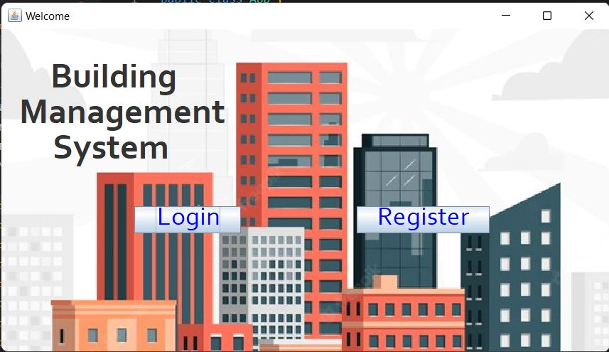
DESIGN DETAILS:

Slide 8
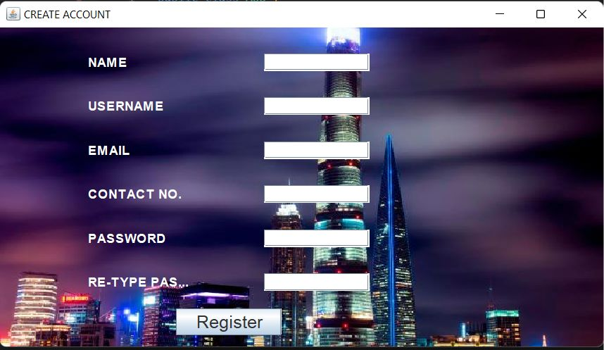

Slide 9
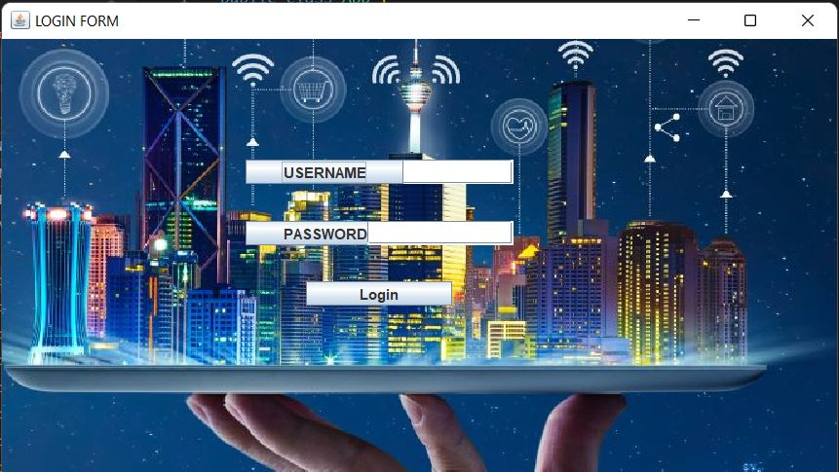

Slide 10
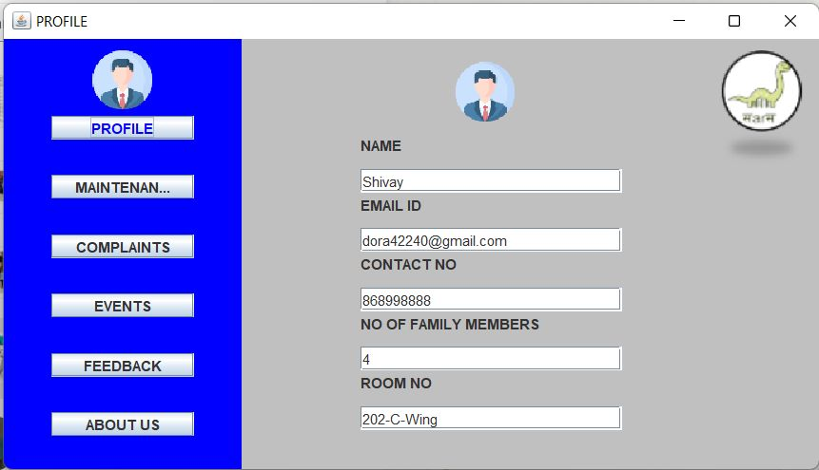

Slide 11
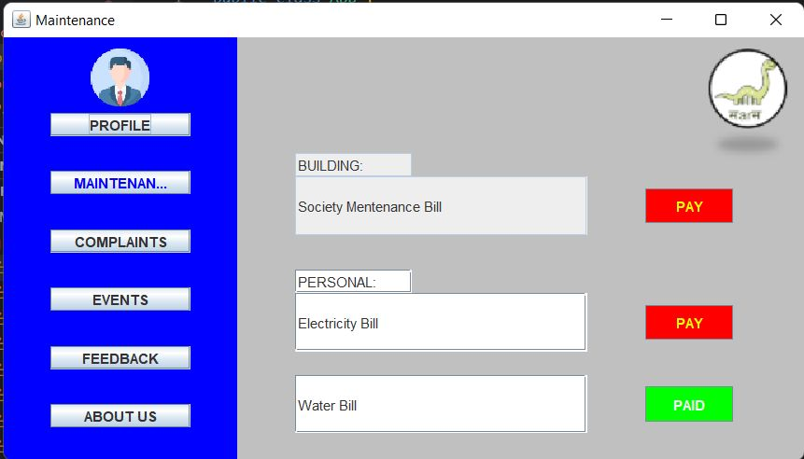

Slide 12
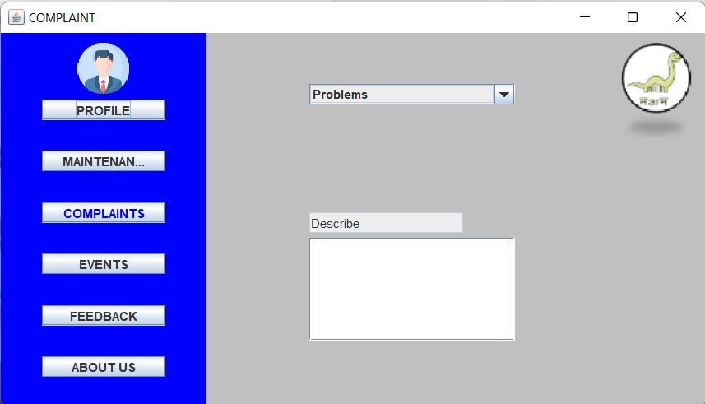

Slide 13
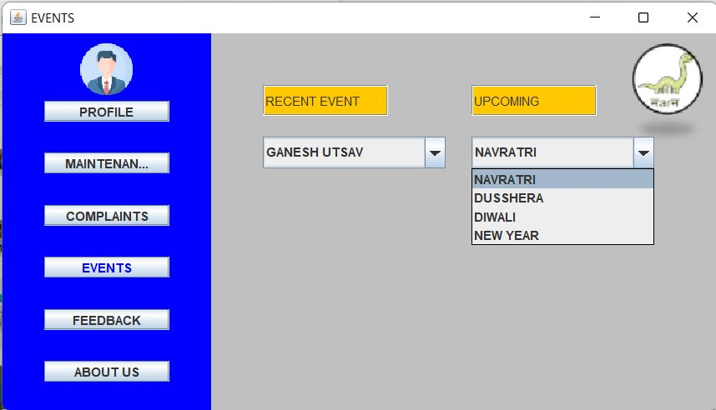

Slide 14
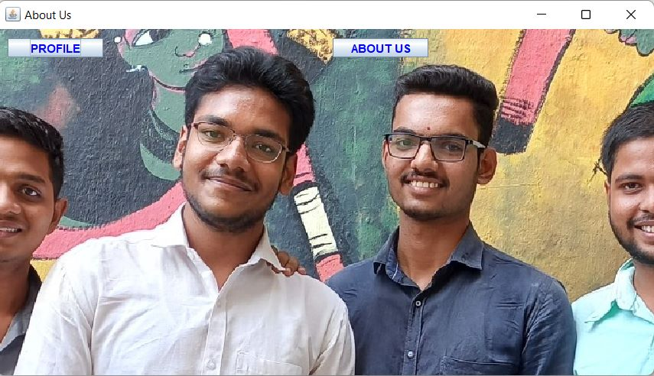

Slide 15
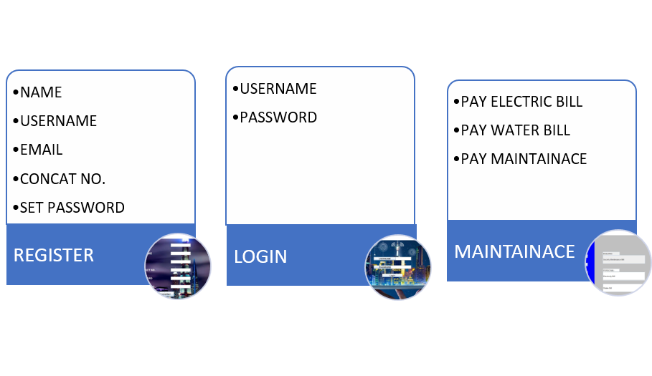
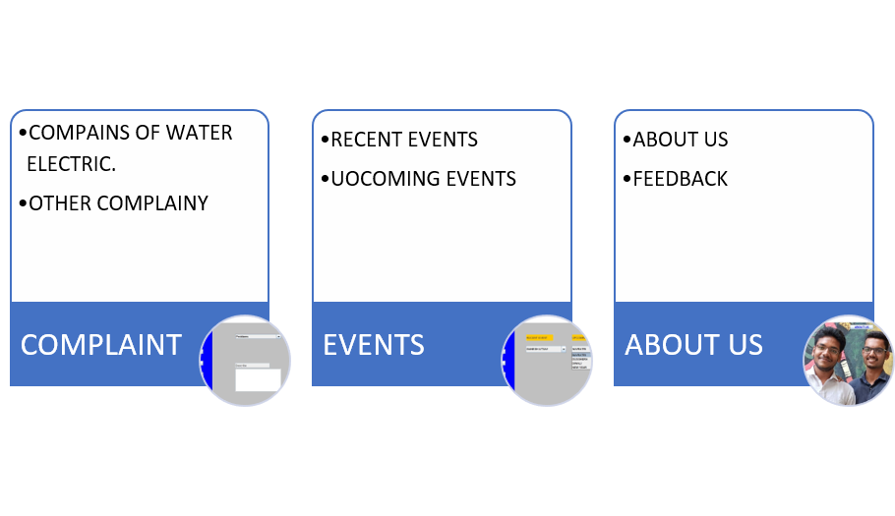
FLOW CHART

Slide 16
RESULT
IN this way we have created BUILDING MANAGEMENT SYSTEM.
We have added some important functions like upcoming events which are going to be celebrated in the society.
We have given access to pay bills like maintenance, electricity and water bills.
And Secretary will have access of all the details of society members.

Slide 17
CONCLUSION
There is always a room for improvements in any apps. Right now, we are just dealing with some operations. There are several management system which serve similar purpose as this project, but these apps were rather difficult to use and provide confusing interfaces. A positive first impression is essential in human relationship as well as in system computer interface. This project hopes to develop a management system with high quality user interface. In future we may be extended to include features.

Slide 18
REFRENCES
Java point web. https://www.google.com/url?sa=t&source=web&rct=j&url=https://www.ja vatpoint.com/javatutorial&ved=2ahUKEwjugfyR5pb7AhUbSmwGHQXjDKgQFnoECBkQ AQ&usg=AOvVaw2WyHO0_1Ll6BRrmgTF41wc
Geeksforgeeks https://www.google.com/url?sa=t&source=web&rct=j&url=https://www.ge eksforgeeks.org/introduction-to-javaswing/amp/&ved=2ahUKEwjp1YDA5pb7AhXDSGwGHflEAY8QFnoECA kQAQ&usg=AOvVaw0ClRnRC3vpkdSh27QSqkTH
Used these youtube videos for learning various java swing implementations and backgroung image setups and JDBC connections etc.
MUKUL SAINI SKILLS CHANNEL

Slide 19
Thank you!!

